Slide 1
FDA Fast-Tracking of Ebola and Zika: HEALTH/IP Lessons
Ana Santos Rutschman
Nova Law Review Symposium
October 14, 2016

Slide 2
Data from Ebola Situation Reports, World Health Organization

Slide 3
The Outbreaks from an IP Perspective
Low pre-existing incentives to R&D
Licensing stalemates during early stages of the Ebola outbreak
Growing fear factor (both Ebola and Zika)

Slide 4
Priority Review Vouchers
2007 neglected tropical diseases (e.g., dengue, malaria, cholera)
2012 rare pediatric diseases
2014 Ebola
2016 Zika

Slide 5
Mechanics of prv
Awarded to sponsor who obtains FDA approval of drug for eligible disease
Voucher can be applied to a second, unrelated drug
Voucher fee: $2.7 million (FY 2016)
Plus: standard new drug filing fee ($2.4 million)
FDA has 6 months to review second drug
Voucher can be redeemed for non-PRV-eligible drugs
Fungible (resale allowed)
PRV as a prize, indirect pull mechanism
PRV as delinkage model from intellectual property

Slide 6
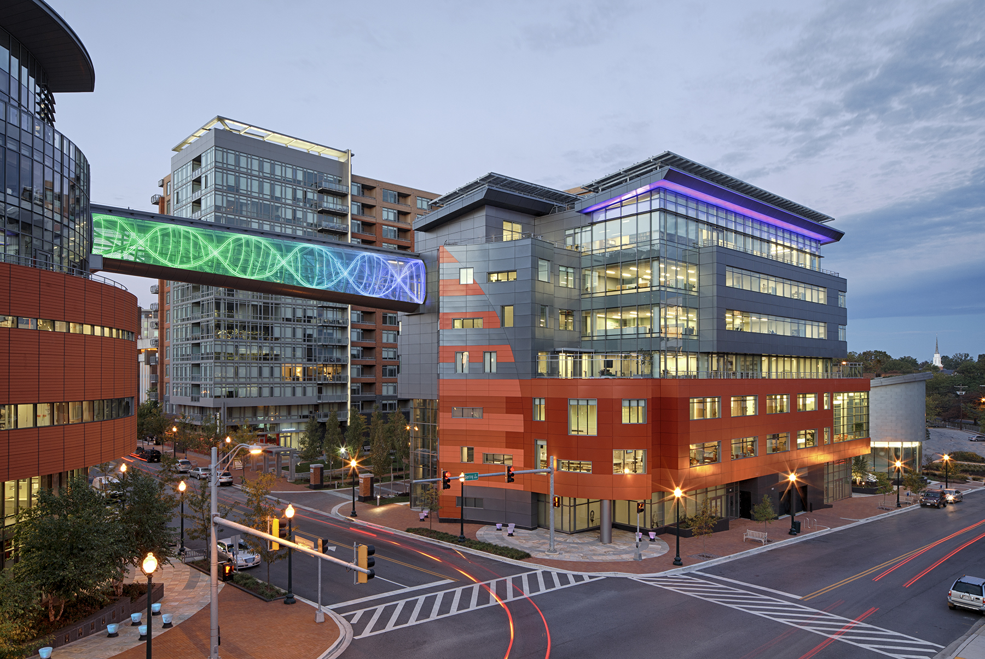
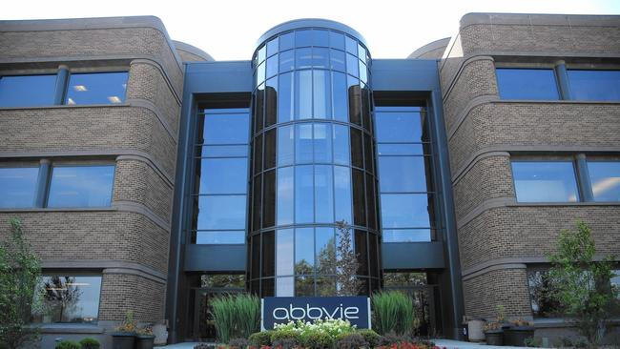
ECONOMIC VALUE OF PRV
$350 MILLION

Slide 7
Company | Disease | History
Novartis | Tropical | Unsuccessfully redeemed by Novartis for Ilaris
Janssen | Tropical | Not used
BioMarin | Rare Pediatric | Sold to Sanofi and Regeneron ($67 million). Successfully redeemed for Praluent
Knight | Tropical | Sold to Gilead ($125 million). Successfully redeemed for Odefsey
United Therapeutics | Rare Pediatric | Sold to AbbVie ($350 million)
Asklepion Pharma | Rare Pediatric | Sold to Retrophin (($75 million). Resold to Sanofi ($245 million). Redeemed for basal insulin/GLP-1combo
Wellstat Therapeutics | Rare Pediatric | Transferred to AstraZeneca. Not used
PaxVax Bermuda | Tropical | Not used
Alexion Pharmaceuticals | Rare Pediatric | Not used
Alexion Pharmaceuticals | Rare Pediatric | Not used

Slide 8
Drugs benefiting from prv
Ilaris – auto-inflammatory diseases
Praluent – cholesterol
Odefsey – HIV
Basal insulin/GLP-1combo – diabetes

Slide 9
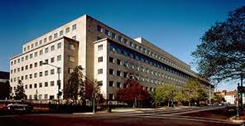
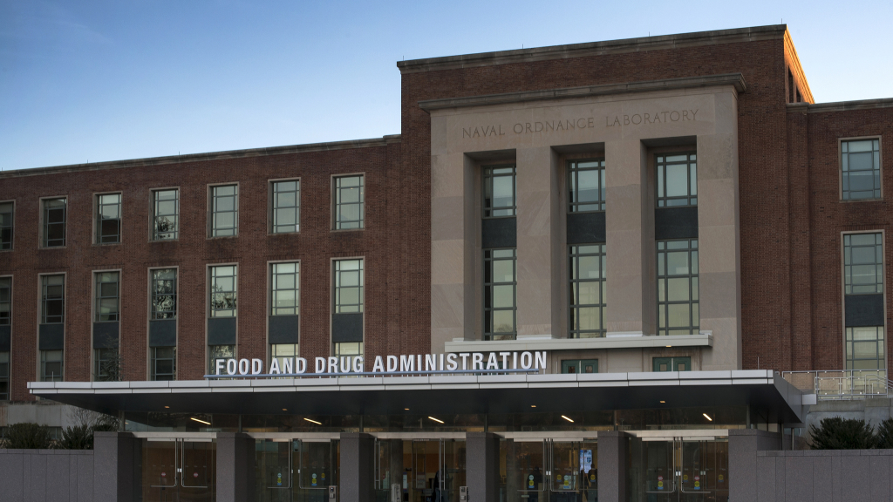
CRITICISM OF PRV
Government Accountability Office (GAO):
Data on rare pediatric diseases is inconclusive
FDA: agency resource displacement
(+impact on goal setting)

Slide 10
Ebola
Outbreak began March 2014
Filoviruses added to PRV in December 2014
Ebola (5 strains), Marburg and Cuevavirus
Most advanced Ebola vaccine candidates:
ChAd3-ZEBOV (GSK; NIAID)
VSV-EBOV (NewLink/Merck; Public Health Agency of Canada)
Phase I clinical trials concluded in January
Phases II and III clinical trials for VSV-EBOV are underway
Formation of partnerships to develop the vaccines pre-dates PRV

Slide 11
ZIKA
Outbreak began May 2015 (officially)
Zika added to PRV in April 2016
Science on Zika significantly less well understood than on Ebola
Three vaccine candidates in Phase I
Inovio (June 2016)
NIH (August 2016)
Bharat Biotech, India (announced October 2016)
Formation of partnerships to develop the vaccines pre-dates PRV

Slide 12
QUESTIONS?
a.rutschman@depaul.edu

